Slide 1
Learn by Doing

Slide 2
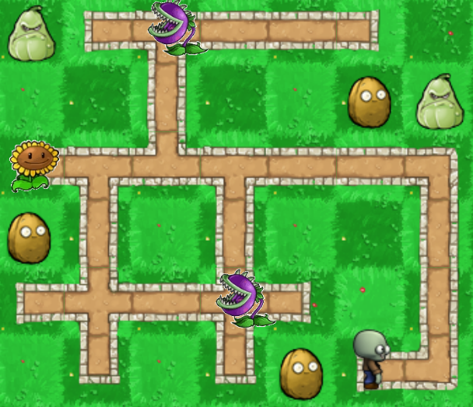
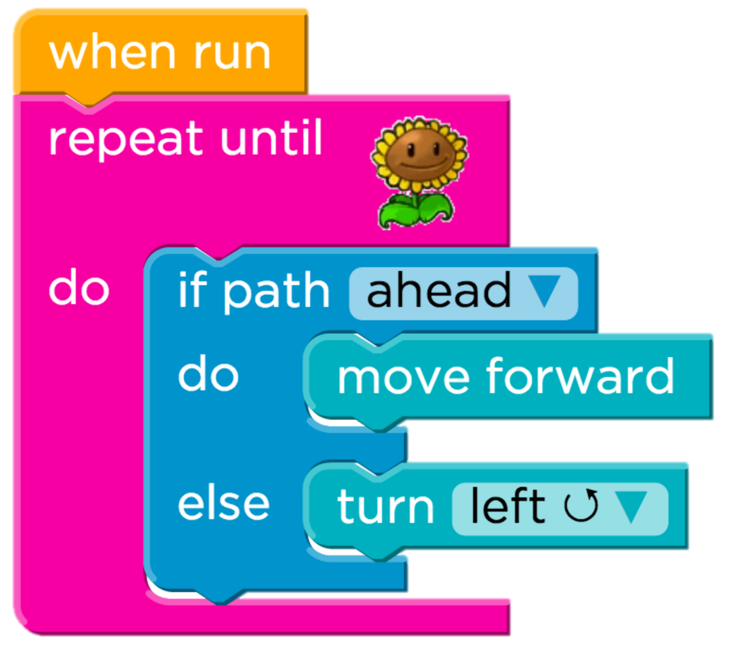
Learning to Program on the Internet
Task
Almost a hundred thousand unique solutions

Slide 3

US K-12 Students
= 500,000 learners

Slide 4
Code.org Students
= 500,000 learners

Slide 5
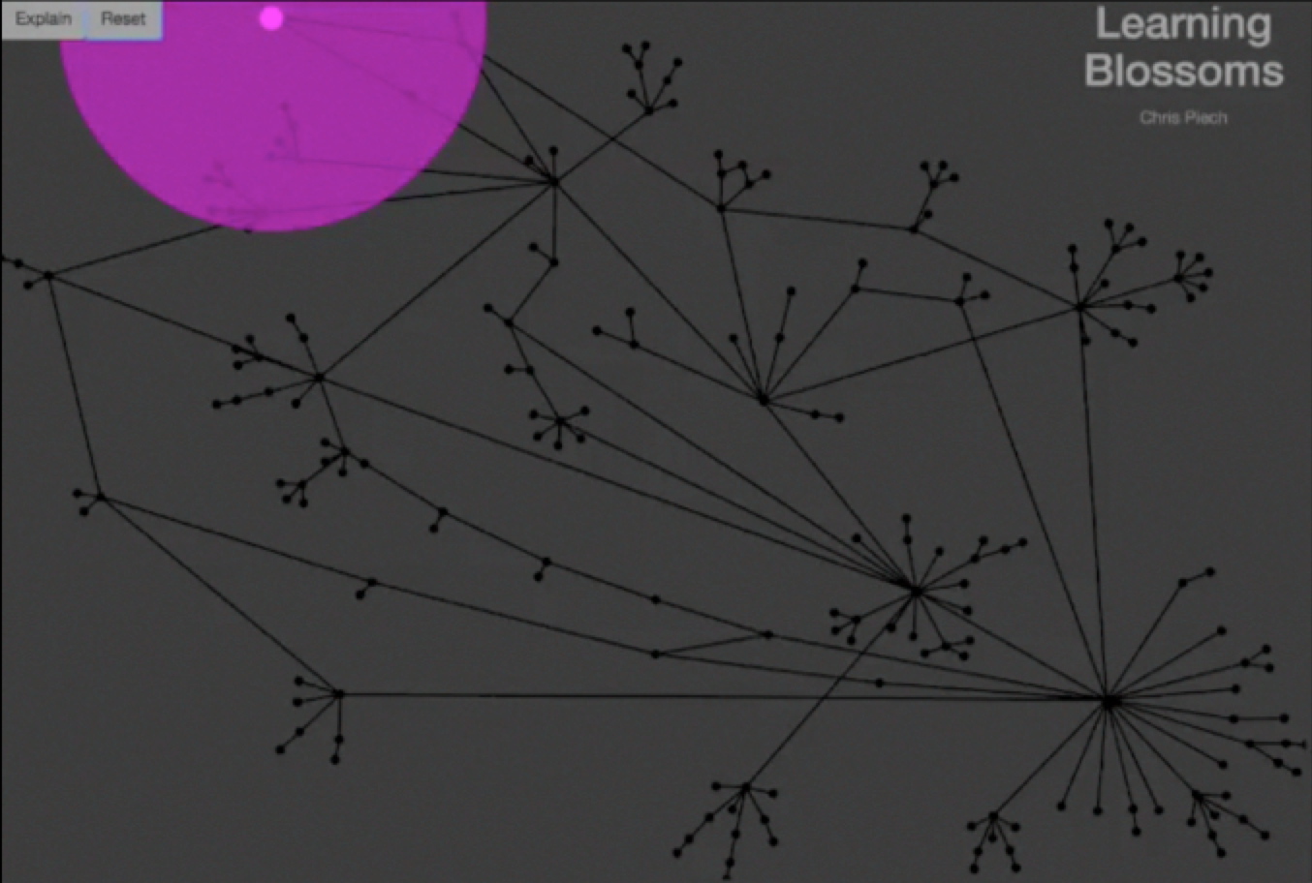
Autonomously Generating Hints by Inferring Problem Solving Policies - Piech, Sahami et al.

Slide 6
Each edge is what a teacher suggested
Pink dots are students.
Each node is a unique partial solution
Solution
Autonomously Generating Hints by Inferring Problem Solving Policies - Piech, Sahami et al.

Slide 7
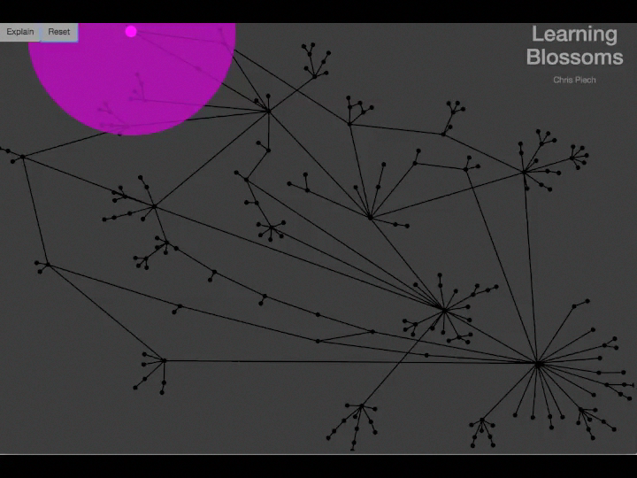
Autonomously Generating Hints by Inferring Problem Solving Policies - Piech, Sahami et al.

Slide 8
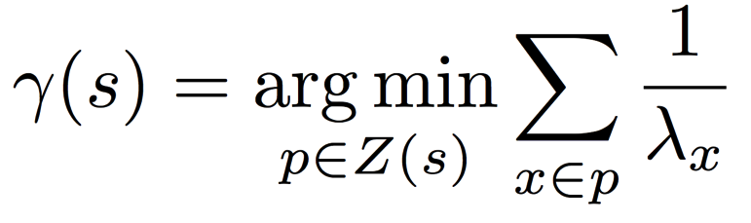
Desirable Path Algorithm
Poisson Common Path
Path Cost
Submission count of partial solution
Predicted next partial solution
Partial solutions in the path
Paths to solution
Notes:
Two algorithms
Both theoretically approximate what an average student would do from a state.
Both are closed form.
Look kinda similar ☺.

Slide 9
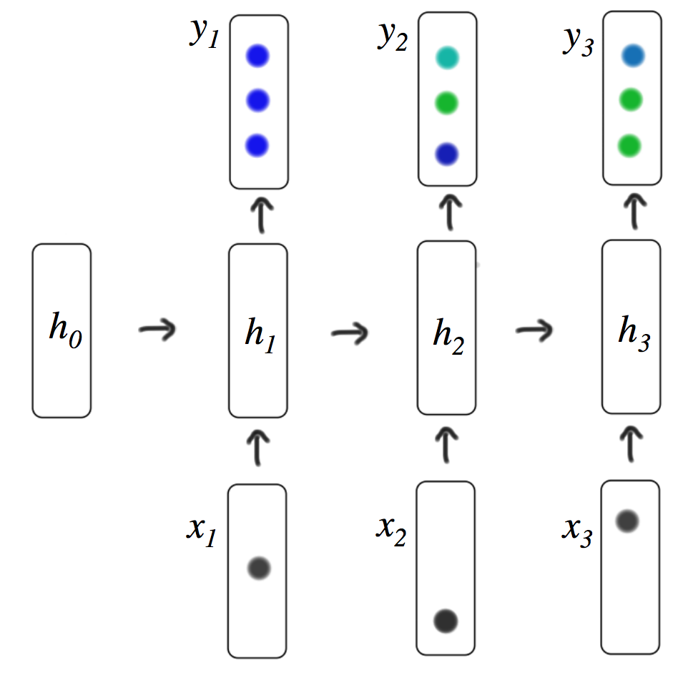
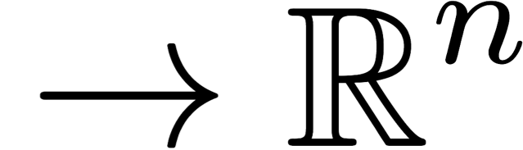


Deep Learning Algorithms
1
2
Program

Slide 10
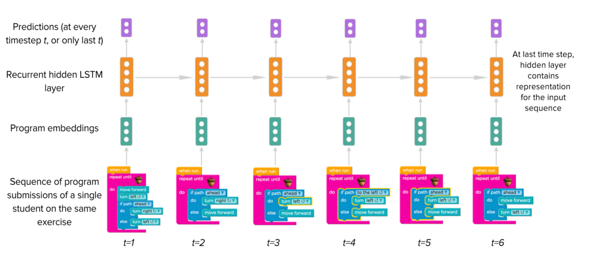
Deep Learning on Trajectories
Research in collaboration with Lisa Wang

Slide 11
Predicts Future Success
Problem A
Problem B

Slide 12
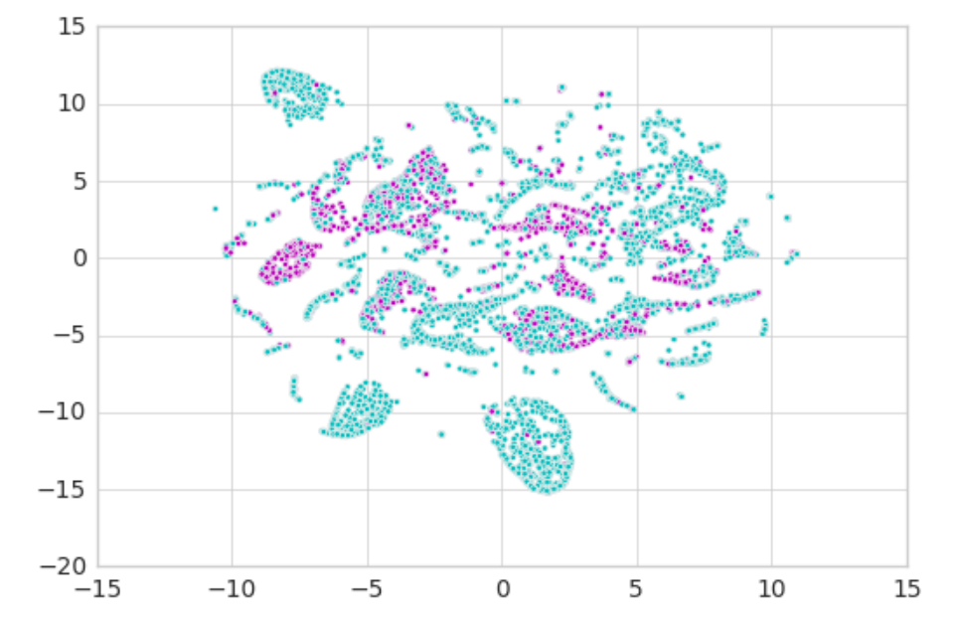
Predicts Future

Slide 13
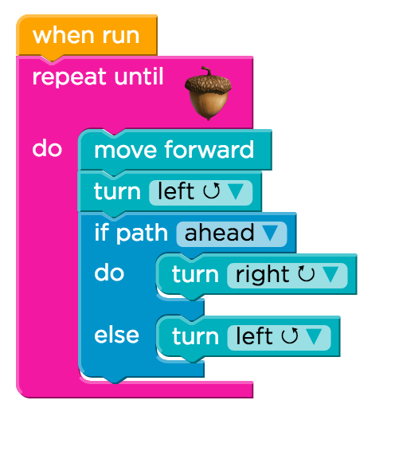
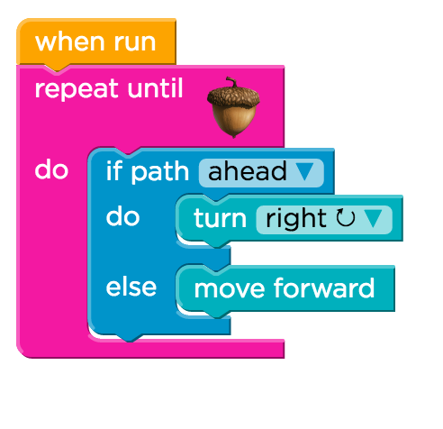
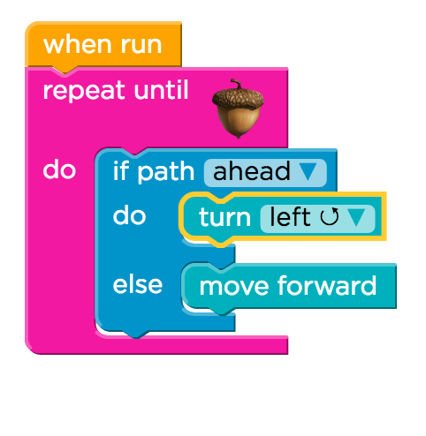
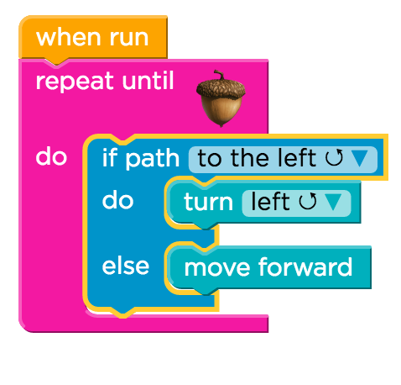
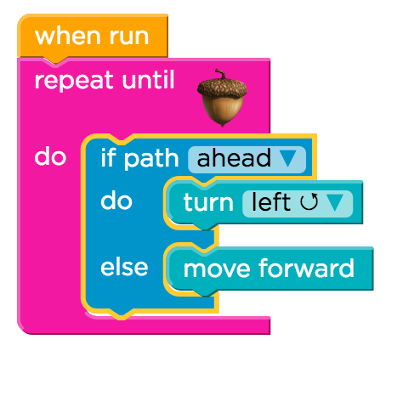
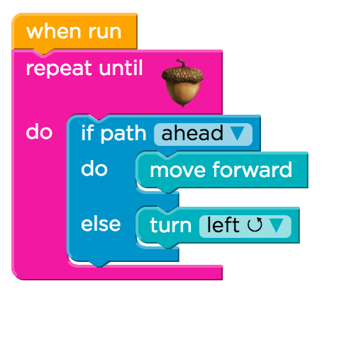
Highly Rates Grit
1. Two compound errors
2. Solves first error
3. Starts reasonable attempt
4. Completes attempt
5. Backtracks
6. Finds solution

Slide 14
Back to our regularly
scheduled programming

Slide 15

Text Processing
Chris Piech
CS106A, Stanford University

Slide 16

Fake Medicine was a Problem
700,000 deaths a year from fake malaria and tuberculosis drugs [1]
Equivalent of this many crashes per day
[1] http://www.un.org/africarenewal/magazine/may-2013/counterfeit-drugs-raise-africa%E2%80%99s-temperature

Slide 17

Chris’ Favorite Program
Bright Simons

Slide 18
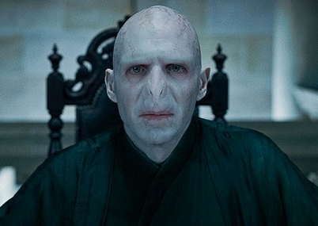
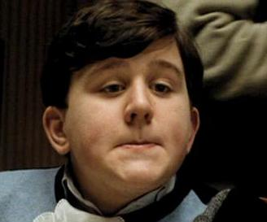

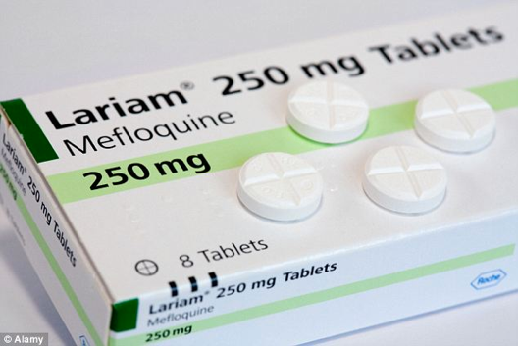
Underlying Puzzle
Counterfeiter
User
You (Distributor)

Slide 19
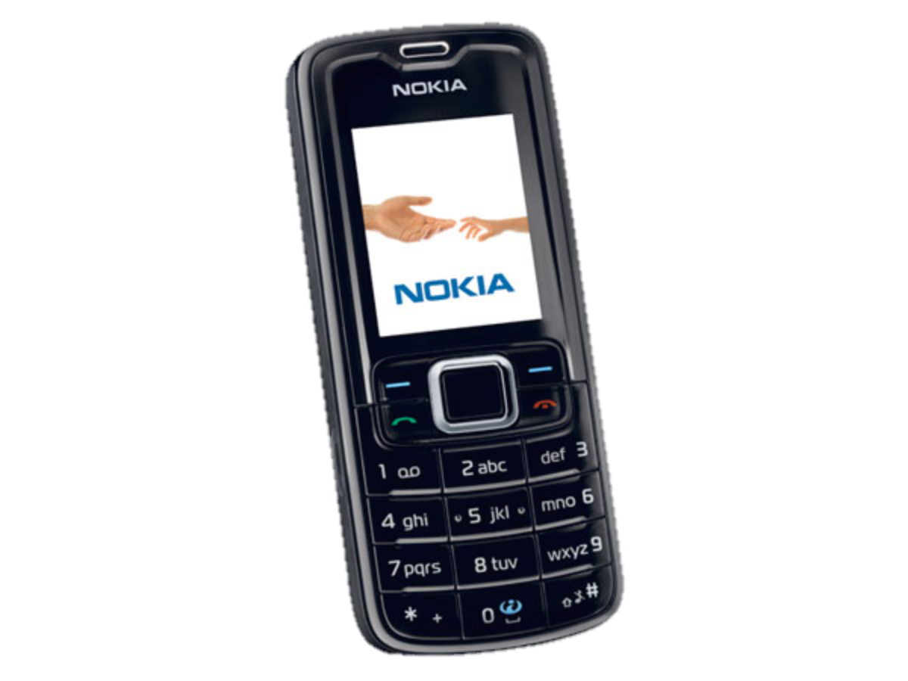
Underlying Puzzle
Counterfeiter
?
User
You (Distributor)

Slide 20
Revisit this problem…

Slide 21

Learning Goals
Write string algorithms that loops over each character
Perform math operations on chars

Slide 22
Text Problem: Decryption
Joan Clarke
Alan Turing

Slide 23
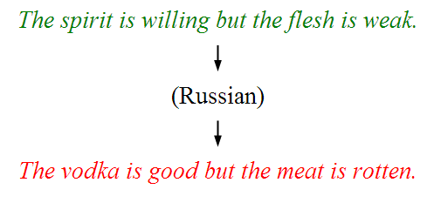
Text Problem: Translation
*This result cost billions of dollars (adjusted for inflation)

Slide 24
Text Problem: DNA Analysis

Slide 25
How is text
represented?

Slide 26
Text is stored using the variable type String.
A String is a sequence of characters.
The variable type String
public void run() {
String text = “hello!”;
println(text);
}
Notes:
Write code that reads in a line of text from the user and echoes it back. First, do “Nubian Ibex”

Slide 27
H
e
l
l
o
!
Notes:
Strings are made of characters.

Slide 28
H
e
l
l
o
!
0
1
2
3
4
5

Slide 29
How it is actually stored
public void run() {
String text = “hello!”;
}
stack
heap
run
28
text
28
Length: 6
H
e
l
l
o
!

Slide 30
H
e
l
l
o
!
0
1
2
3
4
5
text.charAt(index)

Slide 31
All characters in a string have an index.
You can access a character in the sequence via its index

Slide 32
String Methods
The string.length() method returns the number of characters in the string. This is one larger than the last valid index in the string.
the string.charAt(i) method returns the character at a given index.
H
i
m
o
m
(length 6)
0
1
2
3
4
5
Notes:
Review the ourPrintln method, which prints one character at a time.

Slide 33
String Methods
public void run() {
String example = "Hi mom";
// example of length method
int length = example.length();
println(length); // prints 6
// example of getCharAt
char first = example.charAt(0);
println(first); // prints ‘H’
// loop that prints letters one-by-one
for(int i = 0; i < example.length(); i++) {
char ch = example.charAt(i);
println(ch);
}
}
Notes:
Review the ourPrintln method, which prints one character at a time.

Slide 34
String Methods
Console
public void run() {
String example = "Hi mom";
// example of length method
int length = example.length();
println(length); // prints 6
// example of getCharAt
char first = example.charAt(0);
println(first); // prints ‘H’
// loop that prints letters one-by-one
for(int i = 0; i < example.length(); i++) {
char ch = example.charAt(i);
println(ch);
}
}
Notes:
Review the ourPrintln method, which prints one character at a time.

Slide 35
String Methods
Console
public void run() {
String example = "Hi mom";
// example of length method
int length = example.length();
println(length); // prints 6
// example of getCharAt
char first = example.charAt(0);
println(first); // prints ‘H’
// loop that prints letters one-by-one
for(int i = 0; i < example.length(); i++) {
char ch = example.charAt(i);
println(ch);
}
}
example
H
i
m
o
m
0
1
2
3
4
5
Notes:
Review the ourPrintln method, which prints one character at a time.

Slide 36
String Methods
Console
public void run() {
String example = "Hi mom";
// example of length method
int length = example.length();
println(length); // prints 6
// example of getCharAt
char first = example.charAt(0);
println(first); // prints ‘H’
// loop that prints letters one-by-one
for(int i = 0; i < example.length(); i++) {
char ch = example.charAt(i);
println(ch);
}
}
example
length
H
i
m
o
m
6
0
1
2
3
4
5
Notes:
Review the ourPrintln method, which prints one character at a time.

Slide 37
String Methods
Console
public void run() {
String example = "Hi mom";
// example of length method
int length = example.length();
println(length); // prints 6
// example of getCharAt
char first = example.charAt(0);
println(first); // prints ‘H’
// loop that prints letters one-by-one
for(int i = 0; i < example.length(); i++) {
char ch = example.charAt(i);
println(ch);
}
}
6
example
length
H
i
m
o
m
6
0
1
2
3
4
5
Notes:
Review the ourPrintln method, which prints one character at a time.

Slide 38
String Methods
Console
public void run() {
String example = "Hi mom";
// example of length method
int length = example.length();
println(length); // prints 6
// example of getCharAt
char first = example.charAt(0);
println(first); // prints ‘H’
// loop that prints letters one-by-one
for(int i = 0; i < example.length(); i++) {
char ch = example.charAt(i);
println(ch);
}
}
6
example
length
first
H
i
m
o
m
6
‘H’
0
1
2
3
4
5
Notes:
Review the ourPrintln method, which prints one character at a time.

Slide 39
String Methods
Console
public void run() {
String example = "Hi mom";
// example of length method
int length = example.length();
println(length); // prints 6
// example of getCharAt
char first = example.charAt(0);
println(first); // prints ‘H’
// loop that prints letters one-by-one
for(int i = 0; i < example.length(); i++) {
char ch = example.charAt(i);
println(ch);
}
}
6
H
example
length
first
H
i
m
o
m
6
‘H’
0
1
2
3
4
5
Notes:
Review the ourPrintln method, which prints one character at a time.

Slide 40
String Methods
Console
public void run() {
String example = "Hi mom";
// example of length method
int length = example.length();
println(length); // prints 6
// example of getCharAt
char first = example.charAt(0);
println(first); // prints ‘H’
// loop that prints letters one-by-one
for(int i = 0; i < example.length(); i++) {
char ch = example.charAt(i);
println(ch);
}
}
6
H
example
length
first
H
i
m
o
m
6
‘H’
0
1
2
3
4
5
Notes:
Review the ourPrintln method, which prints one character at a time.

Slide 41
String Methods
Console
public void run() {
String example = "Hi mom";
// example of length method
int length = example.length();
println(length); // prints 6
// example of getCharAt
char firstLetter = example.charAt(0);
println(firstLetter); // prints ‘H’
// loop that prints letters one-by-one
for(int i = 0; i < example.length(); i++) {
char ch = example.charAt(i);
println(ch);
}
}
6
H
example
length
first
i
H
i
m
o
m
6
‘H’
0
0
1
2
3
4
5
Notes:
Review the ourPrintln method, which prints one character at a time.

Slide 42
String Methods
Console
public void run() {
String example = "Hi mom";
// example of length method
int length = example.length();
println(length); // prints 6
// example of getCharAt
char firstLetter = example.charAt(0);
println(firstLetter); // prints ‘H’
// loop that prints letters one-by-one
for(int i = 0; i < example.length(); i++) {
char ch = example.charAt(i);
println(ch);
}
}
6
H
example
length
first
i
H
i
m
o
m
6
‘H’
0
0
1
2
3
4
5
Notes:
Review the ourPrintln method, which prints one character at a time.

Slide 43
String Methods
Console
public void run() {
String example = "Hi mom";
// example of length method
int length = example.length();
println(length); // prints 6
// example of getCharAt
char firstLetter = example.charAt(0);
println(firstLetter); // prints ‘H’
// loop that prints letters one-by-one
for(int i = 0; i < example.length(); i++) {
char ch = example.charAt(i);
println(ch);
}
}
6
H
example
length
first
i
H
i
m
o
m
6
‘H’
0
0
1
2
3
4
5
Notes:
Review the ourPrintln method, which prints one character at a time.

Slide 44
String Methods
Console
public void run() {
String example = "Hi mom";
// example of length method
int length = example.length();
println(length); // prints 6
// example of getCharAt
char firstLetter = example.charAt(0);
println(firstLetter); // prints ‘H’
// loop that prints letters one-by-one
for(int i = 0; i < example.length(); i++) {
char ch = example.charAt(i);
println(ch);
}
}
6
H
example
length
first
ch
i
H
i
m
o
m
6
‘H’
0
‘H’
0
1
2
3
4
5
Notes:
Review the ourPrintln method, which prints one character at a time.

Slide 45
String Methods
Console
public void run() {
String example = "Hi mom";
// example of length method
int length = example.length();
println(length); // prints 6
// example of getCharAt
char firstLetter = example.charAt(0);
println(firstLetter); // prints ‘H’
// loop that prints letters one-by-one
for(int i = 0; i < example.length(); i++) {
char ch = example.charAt(i);
println(ch);
}
}
6
H
H
example
length
first
ch
i
H
i
m
o
m
6
‘H’
0
‘H’
0
1
2
3
4
5
Notes:
Review the ourPrintln method, which prints one character at a time.

Slide 46
String Methods
Console
public void run() {
String example = "Hi mom";
// example of length method
int length = example.length();
println(length); // prints 6
// example of getCharAt
char firstLetter = example.charAt(0);
println(firstLetter); // prints ‘H’
// loop that prints letters one-by-one
for(int i = 0; i < example.length(); i++) {
char ch = example.charAt(i);
println(ch);
}
}
6
H
H
example
length
first
i
H
i
m
o
m
6
‘H’
0
0
1
2
3
4
5
Notes:
Review the ourPrintln method, which prints one character at a time.

Slide 47
String Methods
Console
public void run() {
String example = "Hi mom";
// example of length method
int length = example.length();
println(length); // prints 6
// example of getCharAt
char firstLetter = example.charAt(0);
println(firstLetter); // prints ‘H’
// loop that prints letters one-by-one
for(int i = 0; i < example.length(); i++) {
char ch = example.charAt(i);
println(ch);
}
}
6
H
H
example
length
first
i
H
i
m
o
m
6
‘H’
1
0
1
2
3
4
5
Notes:
Review the ourPrintln method, which prints one character at a time.

Slide 48
String Methods
Console
public void run() {
String example = "Hi mom";
// example of length method
int length = example.length();
println(length); // prints 6
// example of getCharAt
char firstLetter = example.charAt(0);
println(firstLetter); // prints ‘H’
// loop that prints letters one-by-one
for(int i = 0; i < example.length(); i++) {
char ch = example.charAt(i);
println(ch);
}
}
6
H
H
example
length
first
i
H
i
m
o
m
6
‘H’
1
0
1
2
3
4
5
Notes:
Review the ourPrintln method, which prints one character at a time.

Slide 49
String Methods
Console
public void run() {
String example = "Hi mom";
// example of length method
int length = example.length();
println(length); // prints 6
// example of getCharAt
char firstLetter = example.charAt(0);
println(firstLetter); // prints ‘H’
// loop that prints letters one-by-one
for(int i = 0; i < example.length(); i++) {
char ch = example.charAt(i);
println(ch);
}
}
6
H
H
example
length
first
i
H
i
m
o
m
6
‘H’
1
0
1
2
3
4
5
Notes:
Review the ourPrintln method, which prints one character at a time.

Slide 50
String Methods
Console
public void run() {
String example = "Hi mom";
// example of length method
int length = example.length();
println(length); // prints 6
// example of getCharAt
char firstLetter = example.charAt(0);
println(firstLetter); // prints ‘H’
// loop that prints letters one-by-one
for(int i = 0; i < example.length(); i++) {
char ch = example.charAt(i);
println(ch);
}
}
6
H
H
example
length
first
ch
i
H
i
m
o
m
6
‘H’
1
‘i’
0
1
2
3
4
5
Notes:
Review the ourPrintln method, which prints one character at a time.

Slide 51
String Methods
Console
public void run() {
String example = "Hi mom";
// example of length method
int length = example.length();
println(length); // prints 6
// example of getCharAt
char firstLetter = example.charAt(0);
println(firstLetter); // prints ‘H’
// loop that prints letters one-by-one
for(int i = 0; i < example.length(); i++) {
char ch = example.charAt(i);
println(ch);
}
}
6
H
H
i
example
length
first
ch
i
H
i
m
o
m
6
‘H’
1
‘i’
0
1
2
3
4
5
Notes:
Review the ourPrintln method, which prints one character at a time.

Slide 52
String Methods
Console
public void run() {
String example = "Hi mom";
// example of length method
int length = example.length();
println(length); // prints 6
// example of getCharAt
char firstLetter = example.charAt(0);
println(firstLetter); // prints ‘H’
// loop that prints letters one-by-one
for(int i = 0; i < example.length(); i++) {
char ch = example.charAt(i);
println(ch);
}
}
6
H
H
i
m
o
m
example
length
first
ch
i
H
i
m
o
m
6
‘H’
5
‘m’
0
1
2
3
4
5
Notes:
Review the ourPrintln method, which prints one character at a time.

Slide 53
String Methods
Console
public void run() {
String example = "Hi mom";
// example of length method
int length = example.length();
println(length); // prints 6
// example of getCharAt
char firstLetter = example.charAt(0);
println(firstLetter); // prints ‘H’
// loop that prints letters one-by-one
for(int i = 0; i < example.length(); i++) {
char ch = example.charAt(i);
println(ch);
}
}
6
H
H
i
m
o
m
example
length
first
i
H
i
m
o
m
6
‘H’
5
0
1
2
3
4
5
Notes:
Review the ourPrintln method, which prints one character at a time.

Slide 54
String Methods
Console
public void run() {
String example = "Hi mom";
// example of length method
int length = example.length();
println(length); // prints 6
// example of getCharAt
char firstLetter = example.charAt(0);
println(firstLetter); // prints ‘H’
// loop that prints letters one-by-one
for(int i = 0; i < example.length(); i++) {
char ch = example.charAt(i);
println(ch);
}
}
6
H
H
i
m
o
m
example
length
first
i
H
i
m
o
m
6
‘H’
6
0
1
2
3
4
5
Notes:
Review the ourPrintln method, which prints one character at a time.

Slide 55
String Methods
Console
public void run() {
String example = "Hi mom";
// example of length method
int length = example.length();
println(length); // prints 6
// example of getCharAt
char firstLetter = example.charAt(0);
println(firstLetter); // prints ‘H’
// loop that prints letters one-by-one
for(int i = 0; i < example.length(); i++) {
char ch = example.charAt(i);
println(ch);
}
}
6
H
H
i
m
o
m
example
length
first
i
H
i
m
o
m
6
‘H’
6
0
1
2
3
4
5
Notes:
Review the ourPrintln method, which prints one character at a time.

Slide 56
numAs

Slide 57
How are characters
represented?

Slide 58
The variable type char
The primitive type char represents a single character or glyph.
Some examples:
char letterA = 'A';
char plus = '+'
char zero = '0';
char space = ' ';
char newLine = '\n'; // special
char first = text.charAt(0);

Slide 59
Enumeration
private static final int FROSH = 1;
private static final int SOPHOMORE = 2;
private static final int JUNIOR = 3;
private static final int SENIOR = 4;
private static final int OTHER = 5;
private int askForYear() {
while (true) {
int year = readInt("Enter class year: ");
if (year >= FROSH && year <= OTHER) return year;
}
}
private void printPopulation() {
for(int year = FROSH; year <= SENIOR; year++) {
printYear(year);
}
}

Slide 60
Chars are just a giant enumeration. You can use math operators on char!

Slide 61
ASCII
* This is only the first half of the table
The letter A, for example, has the ASCII value 65
Using portions of slides by Eric Roberts

Slide 62
‘A’ -> ‘Z’ are sequential.
‘a’ -> ‘z’ are sequential.
‘0’ -> ‘9’ are sequential.

Slide 63
toUpperCase

Slide 64
Useful Character methods
public void run() {
String str = readLine("Line: ");
char ch = str.charAt(0);
println("Original first char: " + ch);
ch = Character.toUpperCase(ch);
println("Uppercase first char: " + ch);
if(Character.isLetter(ch)) {
println("It’s a letter!");
}
}

Slide 65
Useful Character methods
static boolean isDigit(char ch)
Determines if the specified character is a digit.
static boolean isLetter(char ch)
Determines if the specified character is a letter.
static boolean isLetterOrDigit(char ch)
Determines if the specified character is a letter or a digit.
static boolean isLowerCase(char ch)
Determines if the specified character is a lowercase letter.
static boolean isUpperCase(char ch)
Determines if the specified character is an uppercase letter.
static boolean isWhitespace(char ch)
Determines if the specified character is whitespace (spaces and tabs).
static char toLowerCase(char ch)
Converts ch to its lowercase equivalent, if any. If not, ch is returned unchanged.
static char toUpperCase(char ch)
Converts ch to its uppercase equivalent, if any. If not, ch is returned unchanged.
Using portions of slides by Eric Roberts

Slide 66
Strings have some unique properties

Slide 67
Strings are often made through concatenation
public void run() {
String s1 = "CS106";
String s2 = "A";
String s3 = "I got an " + s2 + " in " + s1 + s2;
println(s3);
}
I got an A in CS106A
Notes:
This is not all that new

Slide 68
Strings are Immutable
Java strings are immutable: once a string has been created you cannot set characters.
To change a string:
Create a new string holding the new value you want it to have via concatenation.
Reassigning the String variable (that’s allowed).
Important consequence: if you pass a String into a method, that method cannot modify that string.
Notes:
Show off toUpperCase and toLowerCase. Show that they don't actually modify the string because strings are immutable.

Slide 69
Can survive:
-300F to +300F
Massive radiation
The vacuum of space
Notes:
Water bears are also immutable

Slide 70
Many string algorithms use the “loop and construct” pattern.

Slide 71
Reversing a String
H
e
l
l
o
!

Slide 72
Reversing a String
H
e
l
l
o
!
!

Slide 73
Reversing a String
H
e
l
l
o
!
!

Slide 74
Reversing a String
H
e
l
l
o
!
!
o

Slide 75
Reversing a String
H
e
l
l
o
!
!
o

Slide 76
Reversing a String
H
e
l
l
o
!
!
o
l

Slide 77
Reversing a String
H
e
l
l
o
!
!
o
l

Slide 78
Reversing a String
H
e
l
l
o
!
!
o
l
l

Slide 79
Reversing a String
H
e
l
l
o
!
!
o
l
l

Slide 80
Reversing a String
H
e
l
l
o
!
!
o
l
l
e

Slide 81
Reversing a String
H
e
l
l
o
!
!
o
l
l
e

Slide 82
Reversing a String
H
e
l
l
o
!
!
o
l
l
e
H

Slide 83
Reversing a String
H
e
l
l
o
!
!
o
l
l
e
H
Notes:
Code up reverseString
for (int i = string.length() - 1; i ≥ 0; i--) {
result += string.charAt(i);
}

Slide 84
Reversing a String
H
e
l
l
o
!

Slide 85
Reversing a String
H
e
l
l
o
!
H

Slide 86
Reversing a String
H
e
l
l
o
!
e
H

Slide 87
Reversing a String
H
e
l
l
o
!
l
e
H

Slide 88
Reversing a String
H
e
l
l
o
!
l
l
e
H

Slide 89
Reversing a String
H
e
l
l
o
!
o
l
l
e
H

Slide 90
Reversing a String
H
e
l
l
o
!
!
o
l
l
e
H

Slide 91

reverseString
public void run() {
println("This program reverses a string.");
String str = readLine("Enter a string: ");
String rev = reverseString(str);
println(str + " spelled backwards is " + rev);
}
private String reverseString(String str) {
String result = "";
for ( int i = 0; i < str.length(); i++ ) {
result = str.charAt(i) + result;
}
return result;
}
rev
str
DESSERTS
STRESSED
result
str
i
STRESSED
0
1
2
3
4
5
7
8
S
6
TS
RTS
ERTS
SERTS
SSERTS
ESSERTS
DESSERTS
ReverseString
This program reverses a string.
STRESSED
Enter a string:
STRESSED spelled backwards is DESSERTS
Using portions of slides by Eric Roberts
skip simulation

Slide 92
Useful String methods
int length()
Returns the length of the string
char charAt(int index)
Returns the character at the specified index. Note: Strings indexed starting at 0.
String substring(int p1, int p2)
Returns the substring beginning at p1 and extending up to but not including p2
String substring(int p1)
Returns substring beginning at p1 and extending through end of string.
boolean equals(String s2)
Returns true if string s2 is equal to the receiver string. This is case sensitive.
int compareTo(String s2)
Returns integer whose sign indicates how strings compare in lexicographic order
int indexOf(char ch) or int indexOf(String s)
Returns index of first occurrence of the character or the string, or -1 if not found
String toLowerCase() or String toUpperCase()
Returns a lowercase or uppercase version of the receiver string
Using portions of slides by Eric Roberts

Slide 93
Palindrome
A palindrome is a string that reads the same forwards and backwards.
For example:
Abba
Racecar
Kayak
Mr. Owl ate my metal worm.
Go hang a salami! I'm a lasagna hog.
Elu par cette crapule

Slide 94
What went wrong?

Slide 95
private boolean isPalindrome(String original) {
String reversed = reverse(original);
return reversed == original;
}
stack
heap
isPalindrome
28
original
28
a
b
b
a
reversed
92
92
a
b
b
a

Slide 96
Use .equals to compare strings, not ==

Slide 97
Some test cases
Let's test our program on some examples:
Racecar
Kayak
Mr. Owl ate my metal worm.
Go hang a salami! I'm a lasagna hog.
Will it work?
Notes:
This isn't going to work. Why not? Go to the board – are these strings really equal to their reverses?
Need to convert to lower case, for starters. Then, need to strip out everything besides letters.

Slide 98
Stress Test
A man, a plan, a caret, a ban, a myriad, a sum, a lac, a liar, a hoop, a pint, a catalpa, a gas, an oil, a bird, a yell, a vat, a caw, a pax, a wag, a tax, a nay, a ram, a cap, a yam, a gay, a tsar, a wall, a car, a luger, a ward, a bin, a woman, a vassal, a wolf, a tuna, a nit, a pall, a fret, a watt, a bay, a daub, a tan, a cab, a datum, a gall, a hat, a tag, a zap, a say, a jaw, a lay, a wet, a gallop, a tug, a trot, a trap, a tram, a torr, a caper, a top, a tonk, a toll, a ball, a fair, a sax, a minim, a tenor, a bass, a passer, a capital, a rut, an amen, a ted, a cabal, a tang, a sun, an ass, a maw, a sag, a jam, a dam, a sub, a salt, an axon, a sail, an ad, a wadi, a radian, a room, a rood, a rip, a tad, a pariah, a revel, a reel, a reed, a pool, a plug, a pin, a peek, a parabola, a dog, a pat, a cud, a nu, a fan, a pal, a rum, a nod, an eta, a lag, an eel, a batik, a mug, a mot, a nap, a maxim, a mood, a leek, a grub, a gob, a gel, a drab, a citadel, a total, a cedar, a tap, a gag, a rat, a manor, a bar, a gal, a cola, a pap, a yaw, a tab, a raj, a gab, a nag, a pagan, a bag, a jar, a bat, a way, a papa, a local, a gar, a baron, a mat, a rag, a gap, a tar, a decal, a tot, a led, a tic, a bard, a leg, a bog, a burg, a keel, a doom, a mix, a map, an atom, a gum, a kit, a baleen, a gala, a ten, a don, a mural, a pan, a faun, a ducat, a pagoda, a lob, a rap, a keep, a nip, a gulp, a loop, a deer, a leer, a lever, a hair, a pad, a tapir, a door, a moor, an aid, a raid, a wad, an alias, an ox, an atlas, a bus, a madam, a jag, a saw, a mass, an anus, a gnat, a lab, a cadet, an em, a natural, a tip, a caress, a pass, a baronet, a minimax, a sari, a fall, a ballot, a knot, a pot, a rep, a carrot, a mart, a part, a tort, a gut, a poll, a gateway, a law, a jay, a sap, a zag, a tat, a hall, a gamut, a dab, a can, a tabu, a day, a batt, a waterfall, a patina, a nut, a flow, a lass, a van, a mow, a nib, a draw, a regular, a call, a war, a stay, a gam, a yap, a cam, a ray, an ax, a tag, a wax, a paw, a cat, a valley, a drib, a lion, a saga, a plat, a catnip, a pooh, a rail, a calamus, a dairyman, a bater, a canal – Panama!
Notes:
Try this in our checker – it should work!

Slide 99
Remember!
Counterfeiter
?
User
You (Distributor)

Slide 100
Can you solve it?
Bright Simons

